Slide 1

Module 1 An Overview of Special Education Law

Slide 2
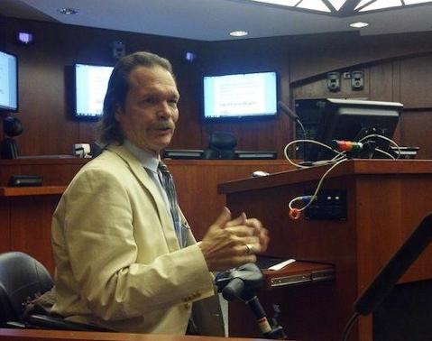
Special Education Attorney: Jim Comstock-Galagan
Served thirteen years (2001-2014) as the Executive Director\Senior Attorney of the Southern Disability Law Center (SDLC) located in New Orleans, LA, with a second office in Austin, TX. Founded in 2001, SDLC is a non-profit legal services organization dedicated to protecting and advancing the legal rights of people with disabilities throughout the South. It partners with the Southern Poverty Law Center, Protection and Advocacy (P&A) programs, Legal Services Corporations (LSC) and disability organizations on major, systemic disability rights issues involving the Individuals with Disabilities Education Act (IDEA), Americans with Disabilities Act (ADA), and the federal Medicaid Act. Recently in November 2014, Jim retired.

Slide 3

matters…
...to EVERYONE!

Slide 4
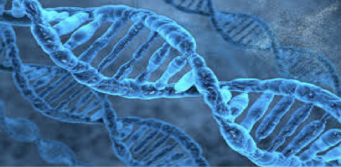
Accommodations...
The DNA of Community Life

Slide 5
Inclusion Matters to Everyone
Accommodations – DNA of All Community Life
Everyone Needs Accommodations to Function in Inclusive School, Work, and Community Settings
We are Far More Alike than Different

Slide 6
Accommodations: DNA of All Community Life
Universal thread of community life
Linchpin of all disability rights legislation- Rehab Act of 1973; IDEA; FHAA and ADA
Today, far too few accommodations are being made for students with disabilities in our schools
Result – Far too many students with disabilities in segregated/self-contained classrooms

Slide 7
Accommodations: DNA of All Community Life
The Irony- every human needs accommodations to function and thrive in community life
Numerous accommodations are made for each and every one of us, each and every day in the community
Several examples of accommodations in any room at any time.

Slide 8
Accommodations…
Think you don’t use ‘em?
Think again.

Slide 9
Accommodations: DNA of All Community Life
Accommodations are necessary in every community setting – home, school, work, social settings, etc.
Why do we need Accommodations?
We all need and use Accommodations to overcome basic human limitations.

Slide 10
Accommodations: DNA of All Community Life
What is a Disability?
A disability is nothing more than a basic human limitation
Who has basic human limitations?
EVERYONE!
As humans we have myriad limitations and extensive capabilities

Slide 11
Accommodations: DNA of All Community Life
Accommodations – make every human less limited, less disabled
A Truth: Accommodations help us
Overcome our various human limitations.
Utilize our abilities
Function in inclusive, natural community settings

Slide 12
Accommodations: DNA of All Community Life
WE ALL NEED THEM
EVERY SINGLE PERSON
EVERY SINGLE DAY
FOR COMMUNITY LIFE
FUNDAMENTALLY - WE ARE FAR MORE ALIKE THAN WE ARE DIFFERENT!!!!!!

Slide 13
Accommodations: DNA of All Community Life
Without accommodations, any person can be rendered totally disabled in a matter of seconds – turn the lights off
We need to stop thinking that some humans are more disabled than others
Reality - all of us have numerous human limitations and all of us need Accommodations to overcome them

Slide 14
Accommodations: DNA of All Community Life
If as humans, we make accommodations for ourselves so that we can function and live in the community
Then we must make Accommodations for students with disabilities so that they can function in inclusive settings in our schools and communities
Equity, Equal Protection, Fundamental Fairness

Slide 15
Inclusion Matters to Everyone
Another Truth – those who say that that inclusion is not important and segregation is okay for persons with disabilities
Never conceive of themselves in segregated settings
Remarkable inability to generalize segregation to their own lives
Fine for someone else, but Not for them

Slide 16
Inclusion Matters to Everyone
And Another Truth – for every person, where one receives services is critically important
Restaurant example
Movie Theater example
Sports Arena example

Slide 17
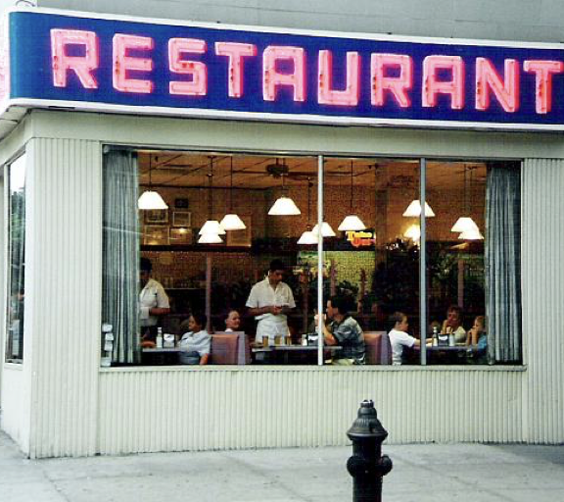
Vic ‘n Natly’s

Slide 18

MOVIE TIME!

Slide 19
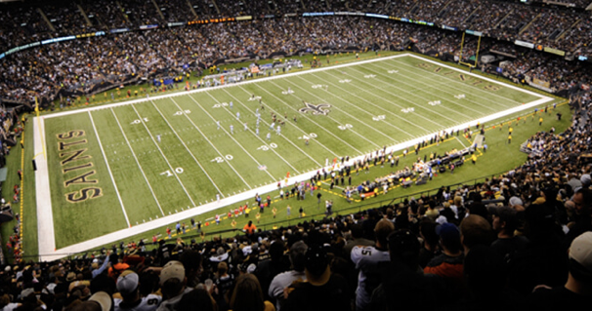
SUPERDOME

Slide 20
Inclusion Matters to Everyone
Definition of Inclusion? Lots of nice, lovely definitions
Don’t need any definitions- everyone here today is living proof of what inclusion is and means
We experience Inclusion everyday as part of community life – it’s a natural component

Slide 21
Inclusion Matters to Everyone
Community Life is defined by inclusion, by belonging
Family
Church
School
Work
Neighborhood
Community organizations

Slide 22
Inclusion Matters to Everyone
Think of or write 2 words that describe the
experience of being included

Slide 23
Inclusion Words
Accepted
Connected
Respected
Valued
Appreciated
Wanted
Contributing
Loved
Belonging

Slide 24
Inclusion Matters to Everyone
Think of or write 2 words that describe the experience of being excluded, left-out.
Every adult has experienced exclusion or rejection at some point

Slide 25
Exclusion Words
Pain
Alone
Despair
Rejected
Angry
Sad
Shame
Empty

Slide 26
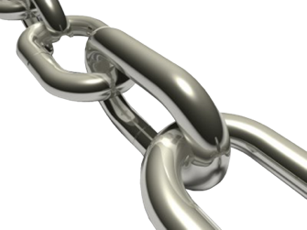
What’s the link
to education?

Slide 27
Intentionally organizing & structuring classrooms, lessons, activities so students
Experience:
Belonging
Contribution
Connection
Respect
Acceptance
Fulfillment
Appreciation
Do Not Experience:
Isolation
Loneliness
Shame
Pain
Helplessness
Low Self-Esteem
Anger
Rejection

Slide 28
Inclusion matters...
To EVERYONE!
DO what you CAN DO to make it happen!

Slide 29
“This is my story; it is the story of a human, not of an invented, or possible, or idealized, or otherwise absent figure, but of a unique being of flesh and blood."
" Yet, what a real living human being is made of seems to be less understood today than at any time before ….every human is more than just him\herself ; he\she represents the unique, the very special and always significant and remarkable point at which the world’s phenomena intersect, only once in this way and never again. That is why every human’s story is important, eternal, sacred!"
HERMAN HESSE, 1925

Slide 30

Next Steps
Free resources for each training module are available for download from the PWSA (USA) website – www.pwsausa.org.
If you need assistance with a school issue, please contact PWSA (USA) at 800-926-4797 and ask to speak to a Family Support Counselor.
If you have questions or comments about this module or the WSEAT in general, please contact Evan Farrar at efarrar@pwsausa.org
No portion of the WSEAT is reproducible without the written permission of PWSA (USA) and/or the presenters of each module.

Slide 31
This concludes the webinar...
Thank you for attending

Slide 32
The Wyatt Special Education Advocacy Training (WSEAT) is generously funded by the PWSA (USA) Willett Fund and a generous grant from the RBC Foundation allowing PWSA (USA) to provide this important training for free to the PWS Community.
The WSEAT is named in memory of David Wyatt who was PWSA (USA)’s first Crisis Intervention and Family Support Counselor.

Slide 33
DISCLAIMER While every effort is made to ensure that the training materials provided in this module are updated with the most recent best practices and developments in the field of special education advocacy and supporting students with Prader-Willi syndrome in school settings this may not always be possible. New developments may occur and not be included in this module of training until it is updated. Additionally, some statements and views in these materials may represent the opinions of the presenter and not necessarily the views of the Prader-Willi Syndrome Association (USA). The information in this training is not intended as legal advice and it should not be relied upon or used for legal purposes. The Prader-Willi Syndrome Association (USA) expressly disclaims any liability for any direct or indirect damage resulting from the use of this training as a whole or parts thereof.

