Slide 1
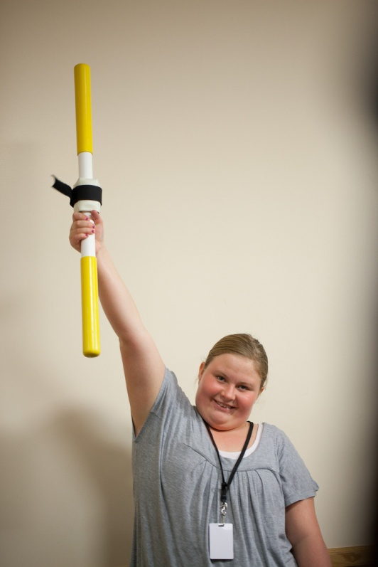
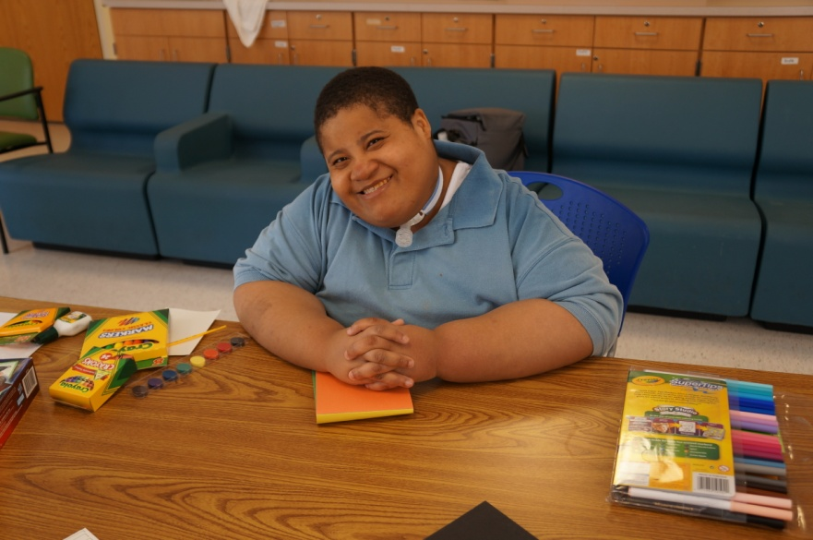

Slide 2
Supporting Students with PWS in the School Setting
Amy McTighe, Ph.D
PWS Program Manager CABLE Coordinator/ Inpatient Teacher The Children’s Institute of Pittsburgh Center for Prader-Willi Syndrome

Slide 3
Agenda
Discuss how students with PWS relate to the IDEA.
Common characteristics related to cognition for students with PWS
Discuss best practices related to writing an IEP for a student with PWS
Discuss best practices related to providing accommodations and modifications for students with PWS in the school setting
Problem Solving Activity

Slide 4
How do students with PWS relate to the IDEA?
ALL students with disabilities are entitled to a “free appropriate public education” (FAPE) that meets their needs and prepares them for post secondary education, employment, and independent living
PWS meets one of the 13 disability categories under IDEA (e.g. OHI, ID, multiple disabilities)
Students with PWS have one of the 13 disability categories AND the need for specially designed instruction.

Slide 5
How do students with PWS relate to the IDEA?
Remember…..Special education is a SERVICE not a PLACE.
Don’t focus on the PLACE (e.g. life skills, learning support, emotional support, etc.) where a student with PWS is NOREPed INTO!
Focus on the specially designed instruction and related services that the student with PWS needs in order to be successful in the educational environment and when transitioning to adult life.

Slide 6
Cognition in Students with PWS
People with PWS have an IQ that can range between 40 and 105 with an average IQ of 70.
Most are within the MLD range with a minority having severe learning disabilities.
The other minority has the intellectual capability to pass GRE exams, college placement exams, or state assessments at the proficient level.
No research based evidence has been found for the wide “scatter” of cognitive abilities.

Slide 7
Cognition in Students with PWS
It is important to note that many students with PWS do not perform up to their “tested” level of ability because of developmental delay at an emotional or social level.
The student with PWS has an insatiable appetite and regardless of there cognitive level will NEVER have control of their craving for food.

Slide 8
Cognition in Students with PWS
Educational settings where students with PWS are placed reflect many variations.
There appears to be a gradual shift from inclusive environments to special needs schools or self contained classrooms as the child gets older.
Behavioral difficulties and food exposure in the school setting becomes a factor
More importantly schools ability to understand and handle the complexity of the syndrome.

Slide 9
Cognition in Students with PWS
There is little evidence to support the theory that the more able the child, the less problematic their behavior is likely to be.
A higher IQ does not seem to be a protective factor against significant behavioral problems in PWS.
Many students with PWS can have a higher IQ, but find it very difficult to engage in safe behaviors when angry or upset.

Slide 10
Strengths for Students with PWS
Long term memory
Receptive language
Reading abilities
Concrete concepts vs. abstract concepts
Jigsaw puzzles, word search type puzzles
Morning is often the best time for engaging in learning activities

Slide 11
Weaknesses for Students with PWS
Weaknesses are often more prevalent in mathematics than in reading
Short term auditory memory- difficulty with understanding verbal instructions, coping with too many instructions at once, picture cues, chunking
Perseveration- asking questions again and again or reverting to the same topic
Abstract thinking and concepts- time concepts, temporal meaning “before” “after” “later”

Slide 12
Weaknesses for Students with PWS
May appear to have learned a topic or concept one day, only to have forgotten it the next
Poor emotional control- tantrums, yelling, aggression, self-injury
Poor social skills
Rigid thinking- what is learned, if not forgotten, will be difficult to “unlearn”

Slide 13
Special Considerations for Students with PWS
Does the student have communication needs?
90% of the time this will be marked - YES
Does the student have behaviors that impede his/her learning or that of others?
90% of the time this will be marked - YES
It is also important to remember that an FBA is recommended to be conducted and a Behavior Plan should be implemented if needed
Example: Food security on the unit= no behaviors

Slide 14
Present Levels of Academic Achievement and Functional Performance
Provide a diagnosis statement that explains Prader-Willi Syndrome and describe in brief what this syndrome entails for others reading the IEP.
Prader-Willi syndrome (PWS) is the most common known genetic cause of life-threatening obesity in children. Although the cause is complex, it results from an abnormality on the 15th chromosome. PWS typically causes low muscle tone. If not treated with growth hormone, persons with PWS may have a short stature or incomplete sexual development. A chronic feeling of hunger is always present coupled with a metabolism that utilizes drastically fewer calories than normal. PWS can lead to excessive eating and life-threatening obesity. Additionally, individuals with PWS are at risk of death from a single incident of uncontrolled eating, which can lead to fatal rupturing of the digestive system. It is important for students with PWS to engage in a food secure environment in the school setting. For more information about PWS, please visit www.amazingkids.org or www.pwsausa.org.

Slide 15
Present Levels - Transitions
Transition goals related to post secondary education, employment and independent living should not have a “food focus”
Examples:
Post Secondary Education- Culinary Programs
Employment- Job shadowing in a food service location (McDonald’s, local restaurant, wiping tables in a cafeteria, etc.)
Independent Living- Food preparation, purchasing food independently in the community, participation in CBI trips related to food

Slide 16
Present Levels - Transitions
For students of transition age, document why transition activities related to food are not being addressed (e.g. food preparation, food shopping, community based instruction trips related to food)
Document why vocational assessment results may not be appropriate for a student with PWS. (e.g food service industry work)

Slide 17
How the student’s disability affects involvement and process in the general education curriculum?
Due to the diagnosis of PWS, the student needs accommodations and modifications to the general education curriculum. These accommodations and modifications include a food secure environment, non-participation in food related lessons, units, or instructional topics during the school day. Food should also not be used as reinforcement in the general education curriculum.
Examples: Nutrition unit in Health, Cooking class, Science unit related to food, Math unit using food manipulatives, etc.

Slide 18
Measurable Annual Goals and Short Term Objectives
Measurable Annual Goals and Short Term Objectives should not focus on food!!!
Examples:
Given a restaurant menu, Jack will independently read 9 out of 10 food words from the menu on 9 consecutive weekly probes (Baseline 0 out of 10)
Given a worksheet with 10 three digit addition problems with regrouping, Jack will independently and correctly solve 9 out of 10 problems on 9 consecutive weekly probes (Baseline 2 out of 10)
Short Term Objective: Given a worksheet with 10 three digit addition problems with regrouping, Jack will independently and correctly solve 5 out of 10 problems on 9 consecutive weekly probes (Baseline 2 out of 10)
Short Term Objective: Given a worksheet with 10 three digit addition problems with regrouping, Jack will independently and correctly solve 7 out of 10 problems on 9 consecutive weekly probes (Baseline 2 out of 10)

Slide 19
Program Modifications and Specially Designed Instruction
Food security in classrooms and locations where instruction and services are received during the school day.
What is meant by this:
Be mindful of garbage cans or containers that may have food items in them. Students with PWS may seek food from garbage cans or containers if not properly supervised.
Teachers and staff should be mindful of food and drink items they may have exposed on their desk during the school day.
Various offices in the school should be mindful of food exposure (e.g. guidance department, main office)

Slide 20
Program Modifications and Specially Designed Instruction
Food related activities should not occur during the school day.
What is meant by this:
Teachers and staff should not use food as reinforcement (e.g. M&M’s for good behavior)
Students with PWS should not participate in food related classes (e.g. home economics) or food related coursework (e.g. buying items from a grocery story ad, reading menu words, etc.)
Students with PWS should not be exposed to community based instruction trips related to food or within a food setting (e.g. going to a restaurant, grocery store to work on independence in the community setting)

Slide 21
Program Modifications and Specially Designed Instruction
Alternative activities of equal interest should be provided during times when food is related to instruction or special events. What is meant by this:
Alternative activities should be provided when a birthday party, holiday party or special event is occurring that involves food.
Ideally, it would be best if these types of activities do not involve food.
The alternative activity should not be viewed as a punishment (e.g. 50 question math worksheet or other academic task)
It should be of interest to the student and then the student should be re-introduced when the food has been cleaned up and put away in a secure area.

Slide 22
Program Modifications and Specially Designed Instruction
Alternative setting for all scheduled mealtimes.
What is meant by this:
It is recommended that the patient not eat snack and/or breakfast/lunch with regular education peers in the cafeteria.
This recommendation is made due to the fact that snack and/or lunch times are often an activity that involves high anxiety and not a time of socialization for a student with PWS.

Slide 23
Program Modifications and Specially Designed Instruction
Structured routine is recommended that provides a clear visual schedule which reflects daily activities.
Set clear expectations for participation in academic and school related activities. Do not make a promise that can’t be kept. This could possibly lead to behavior problems or aggressive episodes.
Don’t provide more information than is necessary, especially far in advance, in order to decrease perseveration and behavior problems.
Provide high levels of verbal praise and positive attention

Slide 24
Program Modifications and Specially Designed Instruction
The student should participate in at least 30 minutes of physical exercise during the day.
Adapted Physical Education
Weekly weight checks with the school nurse
Communication book/system

Slide 25
Program Modifications and Specially Designed Instruction
Specialized transportation is recommended for students with PWS.
When the student gets on the bus in the morning, the parent should hand the packed lunch to the bus driver. Once arriving at school, the bus driver should hand the lunch to an adult. The lunch should be placed in a locked cabinet and provided to the patient at the scheduled lunch time. (This would also be the same if the parent is bringing the student to school in the morning)

Slide 26
Program Modifications and Specially Designed Instruction
School districts that provide a 1:1 behavioral and instructional aide in the school setting during times where there is not TOTAL FOOD SECURITY are the most successful when working with students with PWS!!!

Slide 27
Supports for School Personnel
PWS training for IEP teams, regular education teachers, and/or school staff.
1x or more during the length of the IEP

Slide 28
Problem Solving Activity #1
Case Study #1- Amanda is a student with PWS in your classroom. The Halloween party is scheduled to occur on Friday at 1:00. Activities include students passing out candy to their friends, Halloween cupcakes, and a BINGO game using candy as BINGO markers.
How would you accommodate Amanda in the classroom?

Slide 29
Problem Solving Activity #2
Case Study #2- Jack is a student with PWS in your classroom. You have a behavior system designed that uses a traffic light. If the students stay on “green” all day they get 3 M&M’s. If they are on “yellow” at the end of the day, they get 1 M&M. If they are on “red”, they do not get M&M’s. The M&M’s are stored in a large container on your desk.
How would you accommodate Jack in your classroom with his behavior system in place?

Slide 30
Problem Solving Activity #3
Case Study #3- Lisa is a student with PWS that also participates in the LRE for about 50% of the school day. Her class is scheduled to go on a field trip to the Pittsburgh Zoo. After the students go to the zoo in the morning, they will be stopping at McDonald’s for lunch on the way home.
How do you accommodate Lisa in order for her to participate in this field trip with her classmates?

Slide 31
Problem Solving Activity #4
Case Study #4- Due to Hannah’s diagnosis of PWS, she is currently on a strict caloric diet of 800 calories per day. She is being weighed by the school nurse 1x per week and the weight is recorded in a communication book that is sent home to her parents each day. The past three weeks her weight has increased and she has gained almost 14 pounds.
What would you do to assist Hannah and her family?

Slide 32
Contact Information
PWSA-USA The Prader-Willi Syndrome Association-USA 8588 Potter Park Drive Suite 500 Sarasota, Florida 34238
Dr. Amy McTighe PWS Program Manager Educational Coordinator/ Inpatient Teacher The Hospital at the Children’s Institute of Pittsburgh Center for Prader-Willi Syndrome 1405 Shady Avenue Pittsburgh, PA 15217 amt@the-institute.org
(412) 420-2436

Slide 33
Resources
PWSA-USA School Folder
Information for School Staff: Supporting the Student Who Has PWS Information and Important Basic Understanding for Those Working with Students with PWS
Positive Behavior Strategies- Tips for Educators of Students with PWS
Homework…A Lesson in Frustration
Helping Students with PWS Be Safe Around Food in the School Setting
Attention Teachers: For the Student with PWS Food is NEVER OK in the Classroom!
Helping with Diet Management- Children with PWS at school
Key Components for Success with a Child with PWS in a School Setting
The Student Who Has PWS- Information for Transportation Personnel

Slide 34
Disclaimer
The materials included in this training are intended for training and educational purposes only. Use of these materials is voluntary and they are not intended to replace any professional credentialing, certification, licensure and completion of this training does not infer competency to perform tasks related to other related professional functions.

Slide 35
Disclaimer
While every effort is made to ensure that the training materials are updated with the most recent best practices and developments in the field of focus this may not always be possible. New developments may occur and it may not be possible to revise training materials immediately. Additionally, some statements and views in these materials may represent the opinions of the respected authors. The information in this training is not intended as legal advice and it should not be relied upon for legal purposes. The Children’s Institute expressly disclaims any liability for any direct or indirect damage resulting from the use of this training as a whole or parts thereof.

